Slide 1
Criminal Justice Issues in Schools:
Restorative Justice
Jennifer Mongold
Gracie Good

Slide 2
OBJECTIVES
Relationship between education and the justice system
What is restorative justice?
How is restorative justice applied?
Why restorative justice in schools is important
Practical ways that restorative justice principles are used at Sulphur Springs Elementary School

Slide 3
SCHOOL TO PRISON PIPELINE

Slide 4
Education and Crime Statistics
41% of U.S. inmates do not have a high school degree (Bureau of Justice Statistics)
In Texas between 1999 and 2007, 10 percent of disciplined students eventually dropped out compared to 2 percent of other students (2011).
One in every 10 young male high school dropouts is in jail or juvenile detention, compared with one in 35 young male high school graduates (2009).

Slide 5
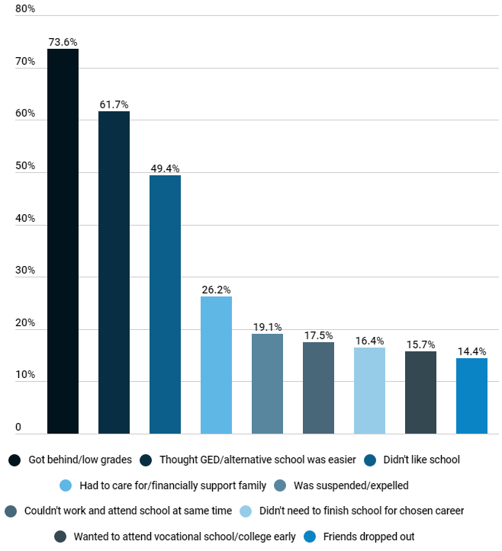

Slide 6
Exclusionary Punishment Issues
Youth that drop out of school seek out gang membership (Barnert et al., 2015; Gass & Laughter, 2015)
Expulsion and suspension disengage the student from academic achievement (Skiba et al., 2014).
Youth that drop out of school are eight times more likely to be incarcerated (Skiba et al., 2014).
Excluding children limits their chances of learning at the same pace as their peers (Justin, 2021).
Suspensions and Expulsions can ultimately cause students to drop out of school (Pigott et al., 2018).
Notes:
Point 1: to find a sense of belonging within a group, to find acceptance from peers, and to combat low self-esteem and negative social interactions because they lack an adult role model

Slide 7
What is Restorative Justice?
RJ is a theory of justice that:
emphasizes repairing the harm caused or revealed by bad behavior
is best accomplished through cooperative processes
includes all stakeholders

Slide 8
Types of Restorative Justice
Mediation after conflict (i.e., fight, bullying, insubordination)
Circles
Restorative Discussions

Slide 9
What does Restorative Justice Offer?
An alternative to exclusionary punishments
Teaching children and teens how to handle conflict
Relationship building
Notes:
Large group question

Slide 10
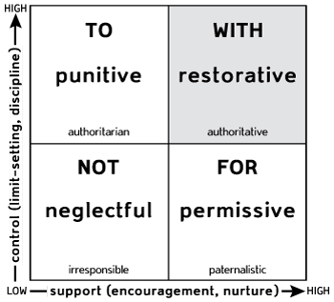
How does Restorative Justice Work?: Social Discipline Window
My Way
Our Way
No Way
Your Way

Slide 11
Retributive V. Restorative Punishments
Restorative
Accountability
Fix the imbalance
Vindication
Retributive (Traditional)
Pain to fix the imbalance
Vindication

Slide 13
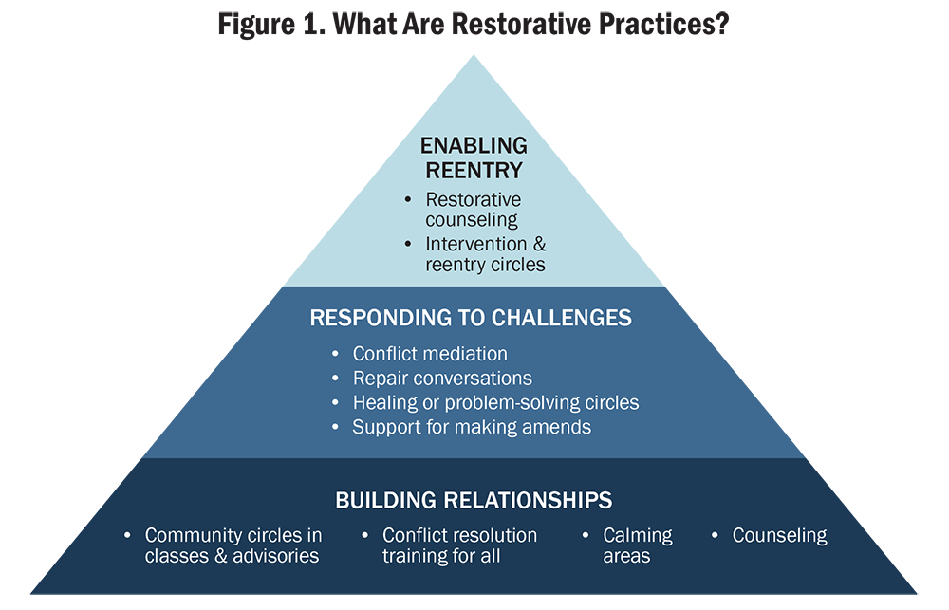
Notes:
In schools, restorative practices positively impact student behavior and school climate. They create a sense of belonging, minimize harm, and support student learning while cultivating students who are better equipped to navigate complex challenges, self-regulate, manage conflict, and become better citizens. They uncover the root causes of conflict and create a space to facilitate complex conversations to minimize harm, repair relationships, and identify solutions.

Slide 14
Notes:
2021- Strong Brain Institute
Building Mission and Vision
Creating a culture and sense of belonging for students

Slide 15
GOALS OF RESTORATIVE PRACTICES
Build Community
Manage Conflict
Repair Harm
Restore Relationships
Give Students a Voice
Establish Safety
Model Sense of Belonging
Practice Empathy

Slide 16
RESTORATIVE PRACTICES AT SULPHUR SPRINGS
RESTORATIVE
CIRCLES
CULTURE
DISCIPLINE
MINDSET SHIFT
PROBLEM-SOLVING
DEN
MATRIX AND BEHAVIOR EXPECTATIONS
RELATIONSHIP BUILDING
SEL
MORNING
MEETINGS
RESET SPACE
CALM DOWN CARTS
VISION AND MISSION
CLASSROOM CONFLICT
CONVERSATION CARDS
STUDENT VOICE
Notes:
Students foster a supportive, respectful, and inclusive school environment that prioritizes the well-being and development of all students.

Slide 17
DISCIPLINE MATRIX EXAMPLE
Classroom Behaviors | 1st Offense | 2nd Offense | 3rd Offense | 4th Offense
Talking Out | VW, Model behavior | C, PC, RGC | 3 Points, LP, RSW | D, RFH
Out of Seat | VW, Model behavior | C, PC, Practice during recess, RGC | 3 Points, LP, RSW | D, RFH
Off Task | VW, Model behavior | C, PC, RGC | 3 Points, LP, RSW | D, RFH
Disruptive Behavior | VW, Model behavior | C, PC, Get a Peer Helper, RGC | 3 Points, PC in person, LP, RSW | D, RFH
Cheating | Redo, C, PC, RGC | 3 Points, PC, RSW | 6 Points, D, RFH | ISS, Support Plan
Homework & Assignments | C, Complete during recess | Complete in office, LP, PC, RGC | PC, D, RSW | D, ISS, RFH
Toys & Distractions | VW, Put away | C, 3 Points, RGC | 6 Points, PC, RSW | PC, D, RFH
Not Following Directions | VW, Model behavior | C, PC, LP, RGC | D, RSW | ISS, RFH
Not Using Time Properly | VW, Model behavior | C, PC, LP, RGC | 3 Points, PC, RSW | D, RFH

Slide 19
CONVERSATION CARDS

Slide 20
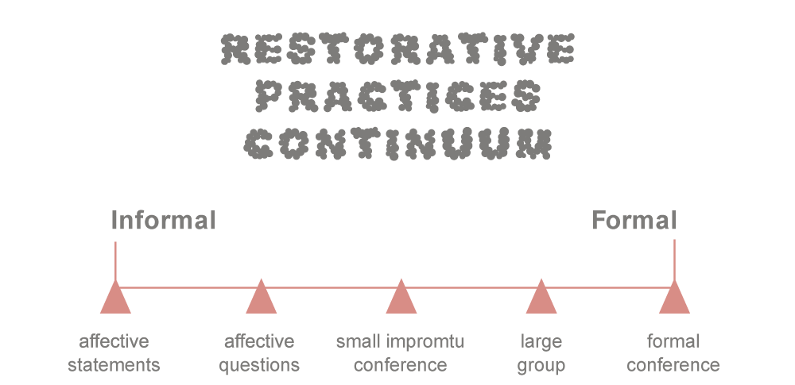
RESTORATIVE PRACTICES IN THE CLASSROOM

Slide 21
RESTORATIVE PRACTICES IN THE CLASSROOM
Restorative Language
Supportive Environment
Promoting Accountability and Repair
Peer Conflict Resolution
Teacher / Student Relationship
Notes:
Fosters empathy and respect for each other, between students and student relationships, but also student and teacher relationships.
​
Helps students learn to listen to each other, creatively problem solve and resolve their own conflicts.
Seeks to understand the why of a student's behavior.

Slide 22
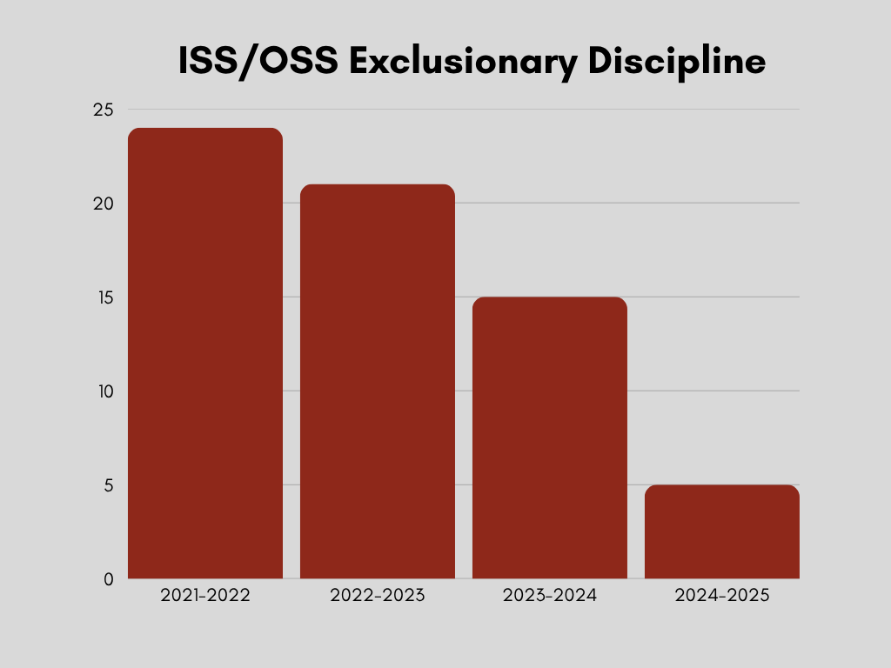
DISCIPLINE DATA
Notes:
Essential Focus - repairing harm, building and cultivating relationships, and promoting conflict management ( Lodi, E., et al. 2022)

Slide 23
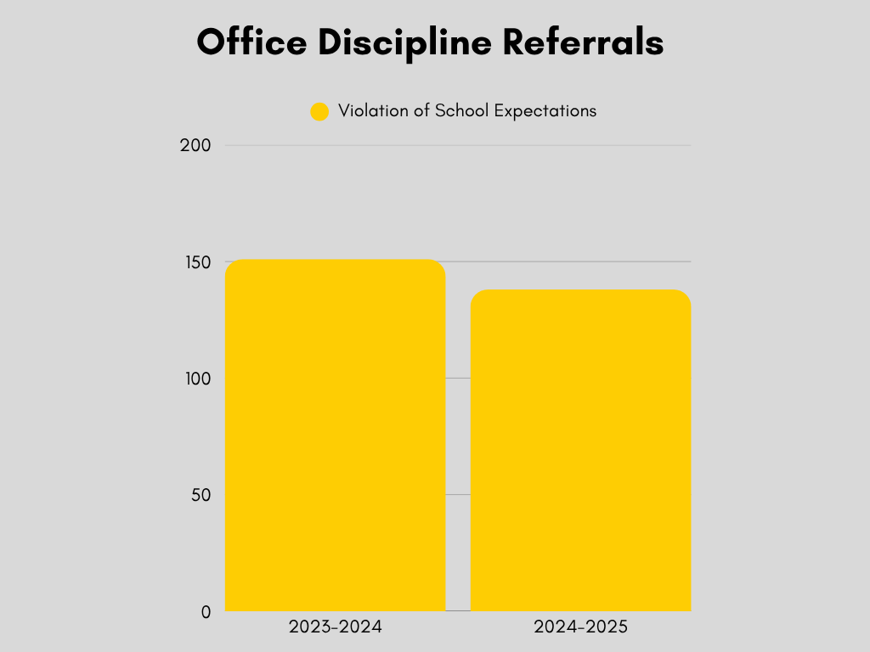
DISCIPLINE DATA
Notes:
Essential Focus - repairing harm, building and cultivating relationships, and promoting conflict management ( Lodi, E., et al. 2022)

Slide 24
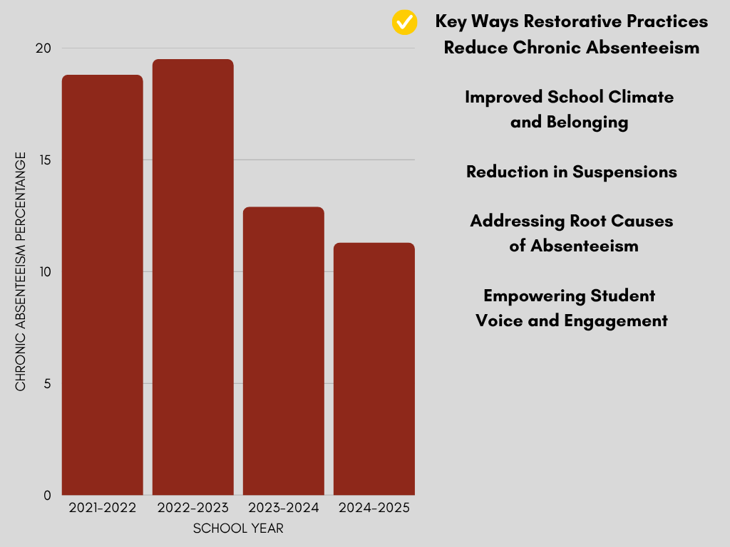
CHRONIC ABSENTEEISM

Slide 25
IMPLEMENTING RESTORATIVE APPROACHES
Utilizing a whole school approach that integrates community-building strategies, interpersonal and conflict resolution skills, and restorative responses to disciplinary incidents
Replacing zero-tolerance and punitive discipline policies with discipline approaches that strengthen relationships
Adopt structures and practices that foster strong relationships

Slide 26
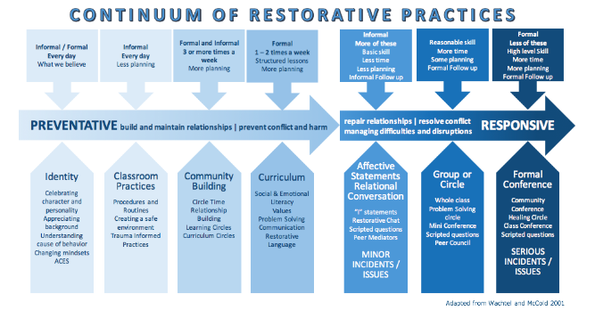

Slide 27
PARTNERSHIPS
East Tennessee State University Resilient Schools Project
Ballad Health
Olweus Bullying Prevention Program
Kingsport City Schools
Unicoi County Schools

Slide 28
Teacher Feedback
“Restorative practices have changed the shape of discipline in my classroom. It has shifted my mindset, but also my students’. It went from “this is against the rules” to “this is the expectation because it keeps us safe, loved, valued, and included.” When students understand expectations and how it impacts others, that they are part of a community, they more likely to own their behaviors.”
Sarah Asbury
(5th grade teacher)
“Restorative practices have created a more supportive, respectful environment where students and staff feel heard, valued, and empowered to grow. I have watched students open up and develop a deeper sense of trust with their peers and teachers.”
Jill Fox
(PE Teacher)

Slide 29
Resources
International Institute for Restorative Practices:
https://www.iirp.edu/professional-development/restorative-practices-for-educators
Strong BRAIN Institute at ETSU:
https://www.etsu.edu/institute/strong-brain/
Gracie Good: goodg@wcde.org
Jennifer Mongold: jlmongold@king.edu

Slide 30
References
Barnert, E. S., Perry, R., Azzi, V. F., Shetgiri, R., Ryan, G., Dudovitz, R., Zima, B., & Chung, P. J. (2015). Incarcerated youths' perspectives on protective factors and risk factors for juvenile offending: A qualitative analysis. American Journal of Public Health, 105(7), 1365–1371. https://doi.org/10.2105/AJPH.2014.302228
Gass, K. M., & Laughter, J. C. (2015). “Can I make any difference?” Gang affiliation, the school-to-prison pipeline, and implications for teachers. Journal of Negro Education, 84(3), 333–347. https://doi.org/10.7709/jnegroeducation.84.3.0333
Justin, E. (2021). Stopping the Flow: Eliminating the school-to-prison Pipeline in Washington State. Seattle Journal for Social Justice, 19(2), Article 17. https://digitalcommons.law.seattleu.edu/sjsj/vol19/iss2/17
Lodi, E., Perrella, L., Lepri, G. L., Scarpa, M. L., & Patrizi, P. (2021). Use of Restorative Justice and Restorative Practices at School: A Systematic Literature Review. International journal of environmental research and public health, 19(1), 96. https://doi.org/10.3390/ijerph19010096

Slide 31
Pigott, C., Stearns, A. E., & Khey, D. N. (2018). School resource officers and the school-to-prison pipeline: Discovering trends of expulsions in public schools. American Journal of Criminal Justice, 43(1), 120–138. https://doi.org/10.1007/s12103-017-9412-8
Skiba, R. J., Arredondo, M. I., & Williams, N. T. (2014). More than a metaphor: The contribution of exclusionary discipline to a school-to-prison pipeline. Equity & Excellence in Education, 47(4), 546–564. https://doi.org/10.1080/10665684.2014.958965
Yang, J. L., Anyon, Y., Pauline, M., Wiley, K. E., Cash, D., Downing, B. J., Greer, E., Kelty, E., Morgan, T. L., & Pisciotta, L. (2018).“We have to educate every single student, not just the ones that look like us”: Support service providers' beliefs about the root causes of the school-to-prison pipeline for youth of color. Equity & Excellence in Education, 51(3–4), 316–331. https://doi.org/10.1080/10665684.2018.1539358

Slide 32
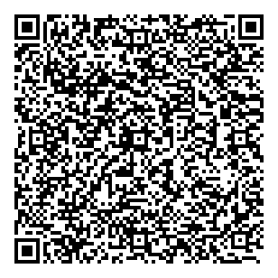
Thank you!

