Slide 1
How to Create A Teacher Voice with Behavior from the Classroom
Notes:
Introduce ourselves

Slide 2
John Sevier Demographics
WHO WE ARE
Kingsport, TN
6th-8th Grade
Approximately 100 staff (67 teachers)
820 students
Designated Title 1 School
100% free and reduced lunch
Notes:
Stephen-28% minority

Slide 3
On PAR

Slide 4
Goal and Purpose
On PAR is a related arts course designed to address students who are struggling to complete work on a regular basis due to effort, will, and attendance.
Students will learn the value of completing class assignments, develop confidence in their academic performance while developing lifelong strategies for work ethic.
Students will learn life skills such as perseverance, time/task management, organization, personal motivation, work avoidance, self-respect, respect for policies and procedures, and other skills that are interfering with student personal success.

Slide 5
How are students placed?
Team teachers will meet biweekly to discuss potential student placements based on lack of completion of work due to effort and/or attendance in their academic classes
Placement into On PAR is solely based on student lack of work being completed.
Once identified, the student and their parent(s) will be notified of the placement and changes will be made into their schedule via Aspen.

Slide 6
Student Expectations
Students will initiate conversations with their On PAR teacher along with their classroom teachers about assignment expectations, necessary assignment materials, and any other relevant information.
Daily, students will monitor Aspen for grades and missing assignments.
Students will work diligently on any missing assignments, test corrections, or re-do assignments to increase participation and understanding.

Slide 7
Student Expectations, cont’d
Students will be expected to communicate with the On PAR teacher and their classroom teachers to initiate and follow up on assignments. This includes gathering needed materials, clarifying expectations, requesting open assignments, and more.
Students will not be permitted to leave the On PAR classroom for any reason, unless called by front office staff. They should collect assignments and make any restroom stops prior to the class
Students will not be allowed to leave the classroom to check with teachers or
visit counseling.

Slide 8
Student Expectations, cont’d
Students will be expected to keep up with current assignments as well as working on previous assignments while enrolled in On PAR.
All school rules apply (i.e. no cell phones).

Slide 9
How do students exit?
Students may exit only at the end of the quarter unless other arrangements have been made prior to the placement.
Exit criteria will be based on the level of improved effort to complete all assignments from each class. If the student level of effort is not sufficient, placement back into the original related arts class will not take place.

Slide 10
Does On PAR impact extracurricular activities?
Being placed in On PAR does not restrict students from participating in and extracurricular activity. Although coaches are strongly encouraged enforce pass for play concept.

Slide 11
OnPAR Tracker
Tracker

Slide 12
The Need for RTI2B and a New Approach to Behavior
Since the 22/23 School Year
ISS numbers have dropped by 140 days.
OSS days have dropped due to behavior by 160 days but have increased overall due to vapes (253 days of OSS and 95 days of ISS during 24/25 year).
Number of days Sevier Middle School students have spent in alternative learning (Cora Cox) has dropped from 597 to 380 days.
Notes:
Stephen

Slide 13
The RTI2B Process
Behavioral Support Flow Chart
Notes:
Sephen

Slide 14
Behavior Management/Tier 1
Anything that can be handled in a class without administration (ISS/OSS).
Classroom Managed vs Admin Managed
Aspen 407-S and 407-O
ISS → Classroom Ejections
→ Expectations
→ Re-entry with restorative process
Staff Crosswalk

Slide 15
Aspen 407-S and 407-O
407S - Staff managed
Informing admin of behavior
Teacher contacts home
Teacher gives consequence
407O - Office managed
Admin needs to take action
Admin contacts home
Admin gives consequence
Notes:
Seaver

Slide 16
Check In/Out Process (Tier II Support)
Check In/Out Form
Reasons to use CICO:
Provides structure in a student’s day
Creates accountability
Provides teacher feedback to student and parents
Creates internal motivation
Improves student behavior
Increases academic success
Creates a stronger home-school connection
Notes:
Kathleen

Slide 17
Behavior Tracking Sheet (Tier 2A and Tier 2B)
Grade Level Behavior Tracking Form 2022-2023 (Presentation)
A clearly defined, systematic identification process that will allow for early identification of students who are at-risk, thereby decreasing the likelihood of behavior issues and poor outcomes and minimizing the impact of risk. By providing preventative support early, the need for more intensive support is reduced.
Notes:
Kathleen

Slide 18
The Next Step from TIER 2B (Tier III Supports)
Referral to the Evaluation Committee for Warrior Academy
The committee includes
Administrators
An academic teacher from each grade level
Warrior Academy Teacher
The committee meets and determines placement into Warrior Academy.
The Warrior Academy team makes a home visit with the administration and goes over the Warrior Academy handbook.
Notes:
Stephen

Slide 19
The Warrior Academy Handbook
Warrior Academy Handbook
Points Sheet
WA Teacher Check-ins
Notes:
Both of us

Slide 20
Warrior Academy Schedule
7:00-7:45 Greet Students
7:45-8:15 Breakfast/Check-In
8:15-11:00 Academic Time
11:00-11:30 SEL Time
11:30-12:00 Lunch
12:00-1:00 Reading
1:00-2:30 Academic Time
2:30-2:45 Daily Point Accountability
Notes:
Stephen

Slide 21
Warrior Academy Weekly Activities
Weekly Counseling Visits
Service Learning
Small Miracles -- equestrian farm
Dobyns Bennett -- special needs mentoring in an FA1 class
Feel Good Fridays Coffee Cart
Guest Speakers
Navy Seal
Community Leaders and Athletes
High School Principal
Superintendent
Notes:
Stephen

Slide 22
RTI Successes
We decreased days of suspension from 287 days of ISS and 232 days of OSS in 2017 to 147 days of ISS and 167 days of OSS by the end of November 2018.
Improved attendance
Fewer bus referrals
An improved focus on relationship building and teacher involvement in restorative practices and RTIB2.
Notes:
Both of us

Slide 23
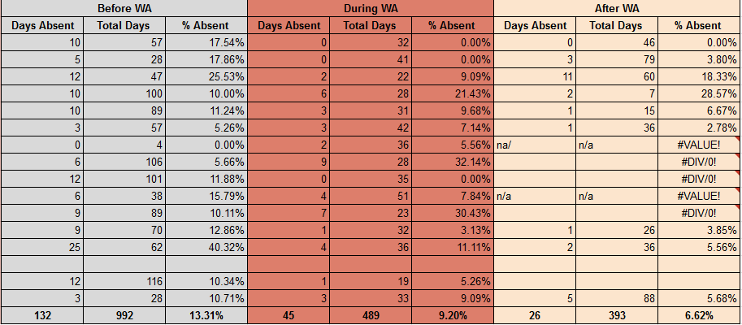
Attendance Success 2018/2019
Notes:
Both of us -- talk about Covid

Slide 24
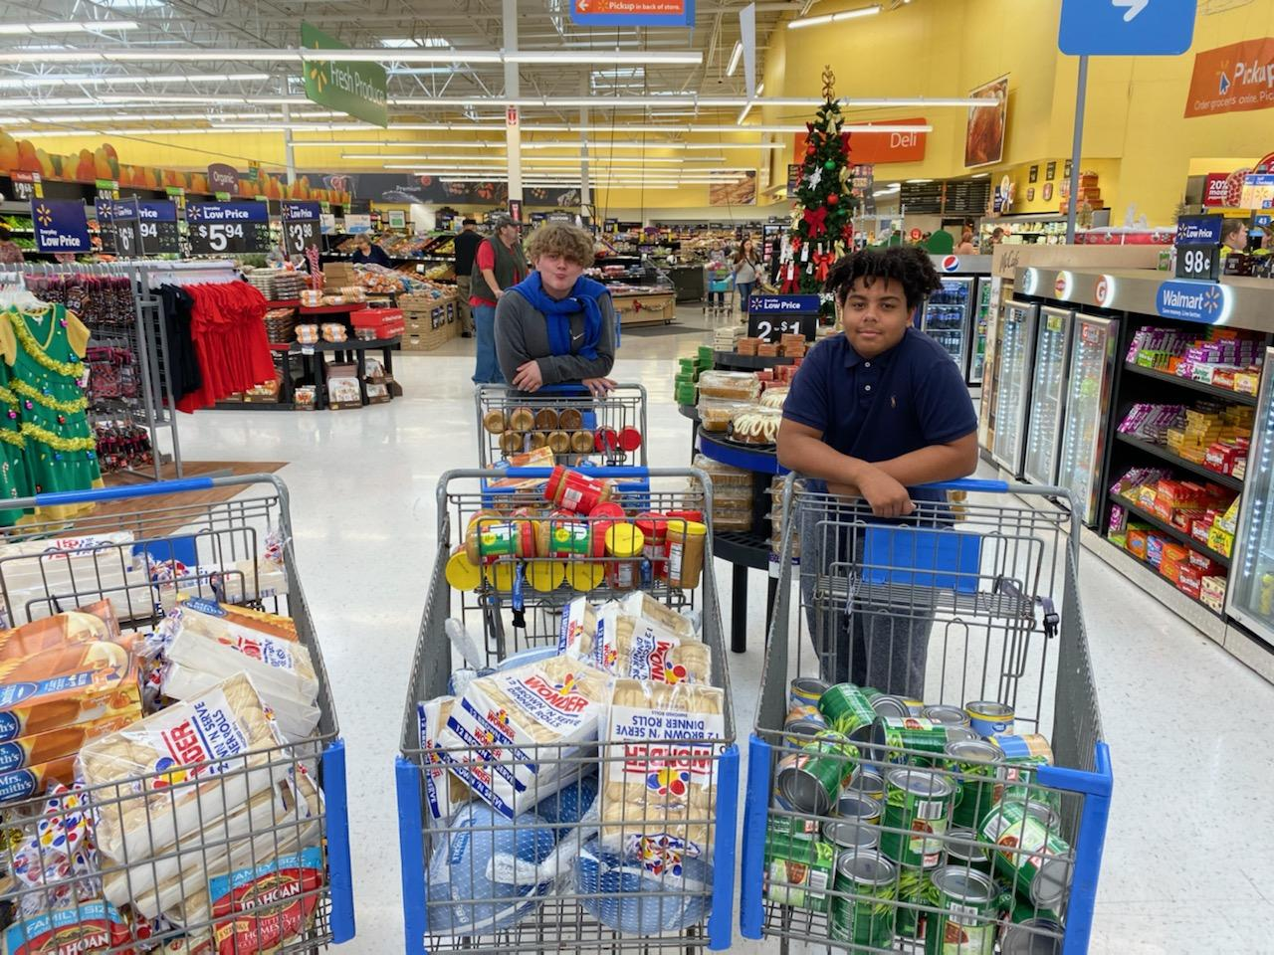
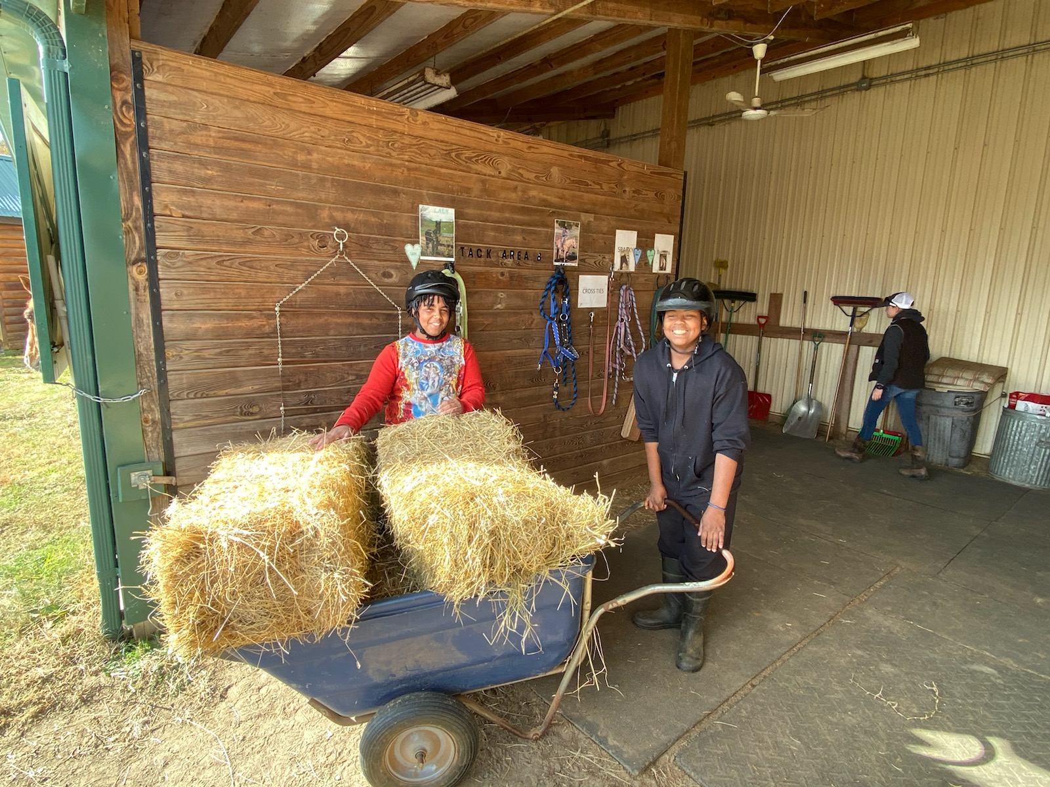
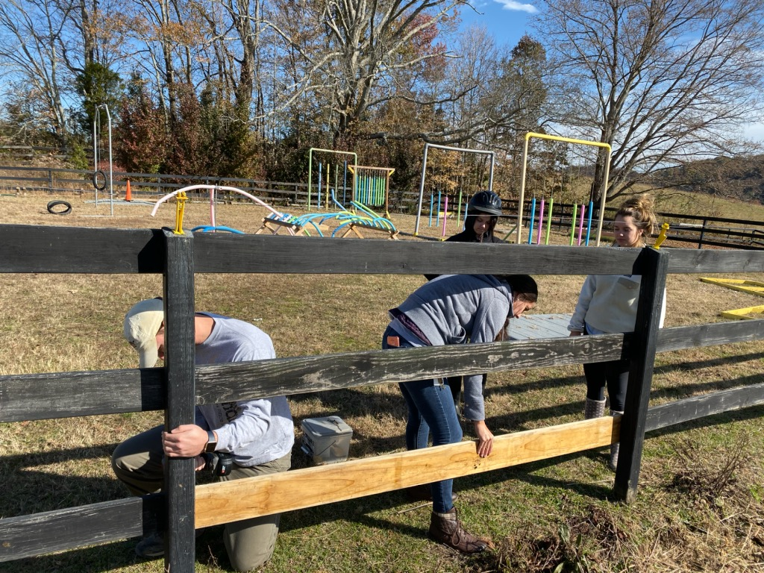
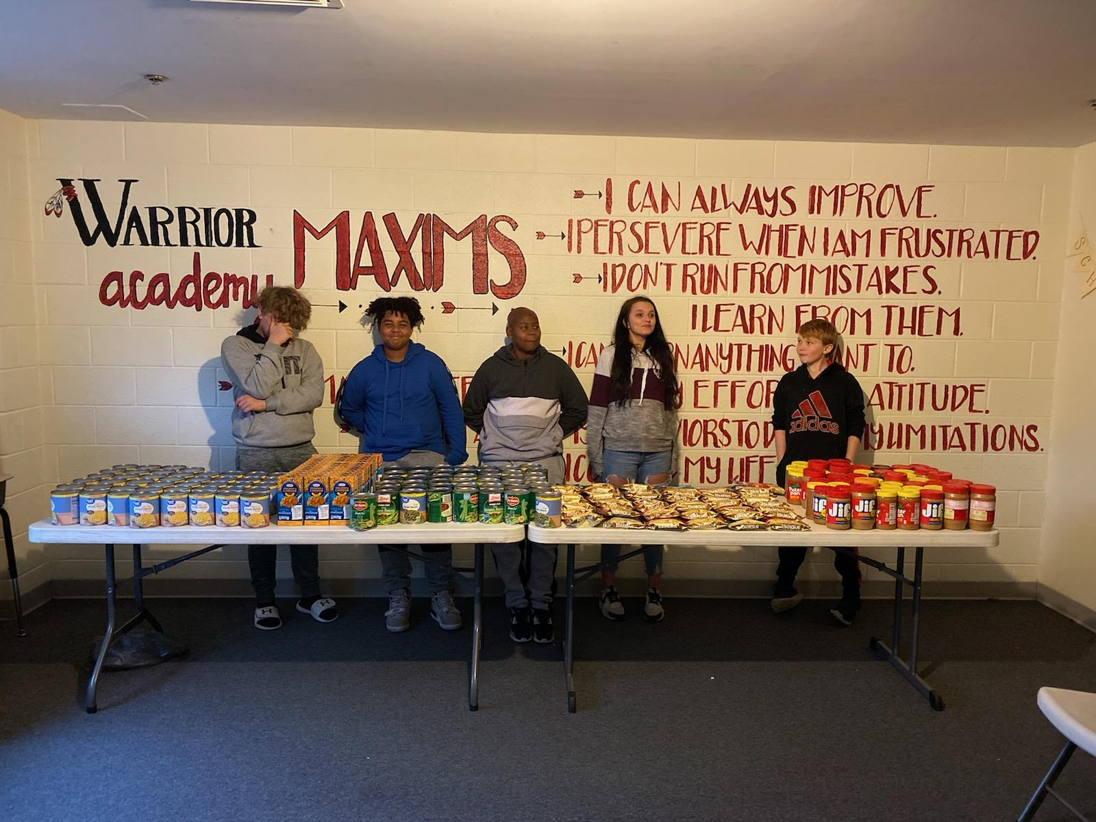
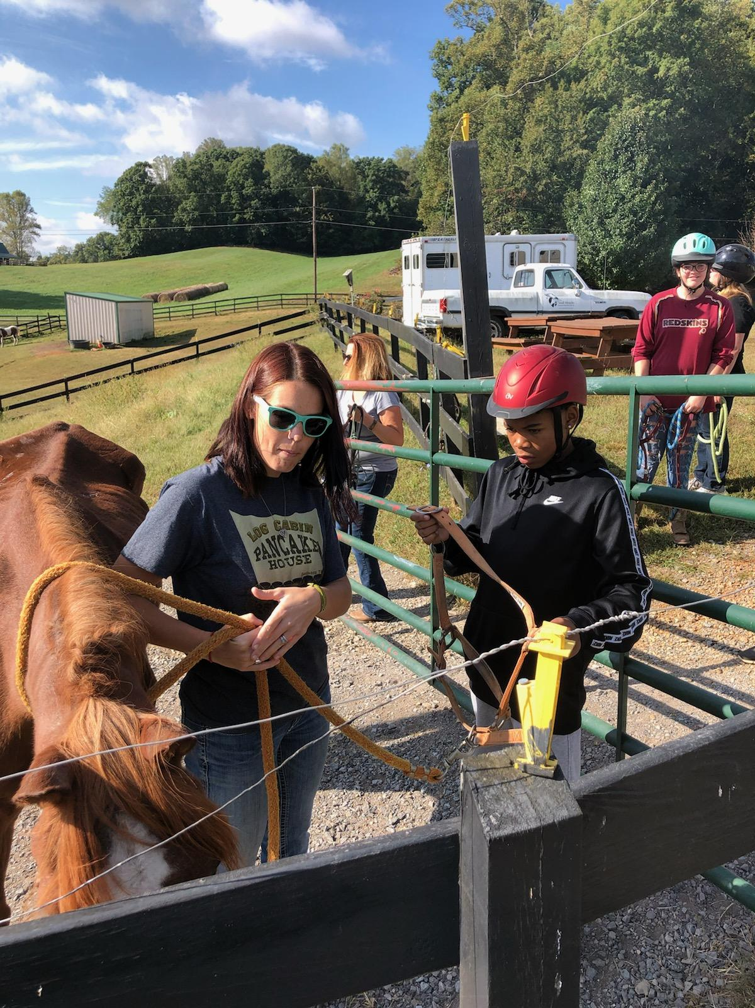
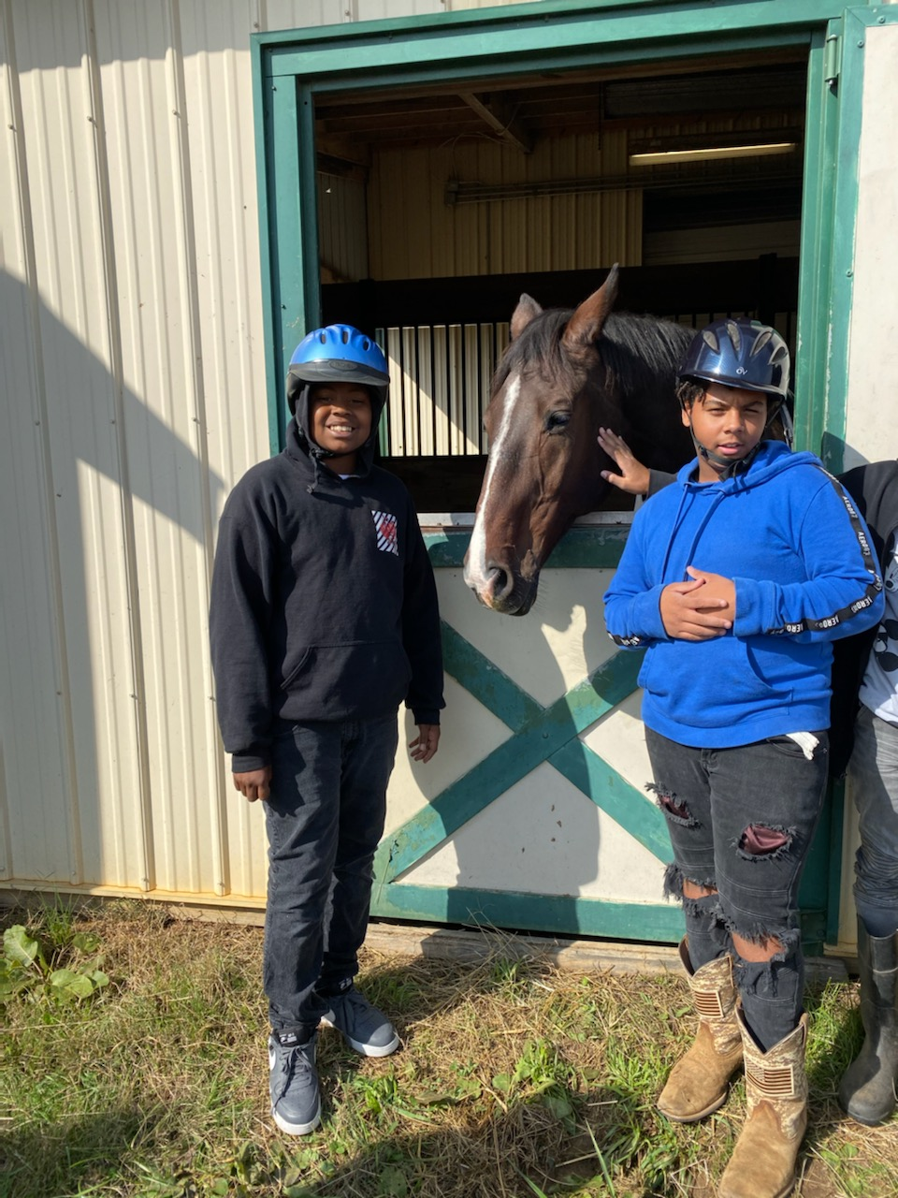
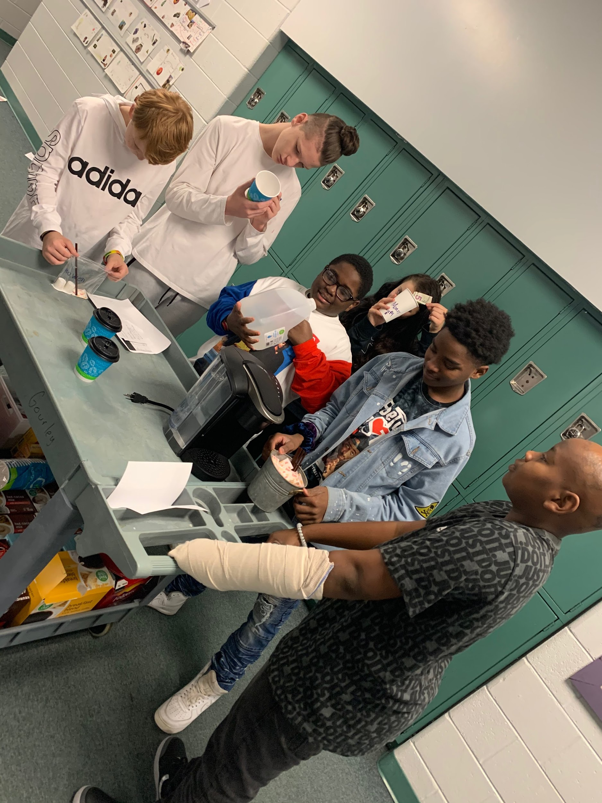

Slide 25
When to Conduct a Functional Behavioral Assessment
(FBA)

Slide 26
Reflecting on Behaviors that Challenge Us
What behaviors push your buttons?
_____
2. ______
3. _____

Slide 27
When To Conduct a
Functional Behavioral Assessment (FBA)
When a student is receiving Special Education and Related Services engages in conduct that results in a change in placement as defined by 34 C.R.F. 300.536
The student’s conduct that gave rise to the change in placement was, in fact, a manifestation of the child’s disability.
Notes:
Behaviors must be chronic and ongoing.

Slide 28
When To Conduct a
Functional Behavioral Assessment (FBA)
Basic classroom management techniques are not effective.
Basic behavioral interventions are not effective.
Injurious behaviors to self or others.
Frequency and intensity of behavior is across settings and disrupt the learning environment.
Notes:
Behaviors must be chronic and ongoing (pattern). There is an identifiable selection on all IEPs that ask if the behaviors are impacting the learning of the student or other students.

Slide 29
Determine the Behavior’s Function
Collecting Data (Student, Teacher, Parent)
Interviews
Behavior Rating Scales
Observations
ABC Model
Function of the Behavior
Obtain
Or
Avoid
Notes:
You are trying to identify the skill deficit!

Slide 30
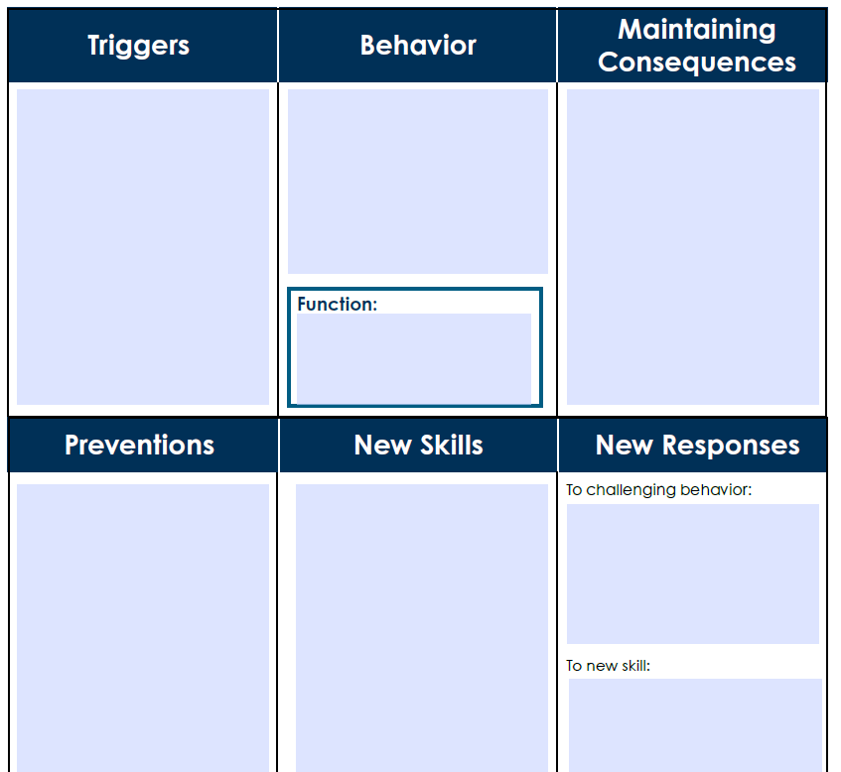
Support Planning Chart

Slide 31
Understanding the Behavior
Intervention Plan (BIP)
Structured
Individualized
Modify precise behaviors
Team Approach
Cognitive, Emotional, and Behavioral delays Impacting behavior
Notes:
The BIP is a contract between staff members where they formally commit to taking action steps to prevent challenging behaviors by identifying triggers, modifying the environment to de-escalate or prevent behaviors, and teach replacement behaviors.

Slide 32
Components of BIP
Target Behavior (frequency, intensity, and duration)
FBA Information (A-B-C)
Identification of replacement behavior
Identification of new strategies (you must teach)
Response strategies (for challenging behavior)
Tools for monitoring and data collection

Slide 33
Identification of Challenging Behaviors
Disruptive behaviors
Aggressive behaviors
Withdrawn behaviors
Self-injurious behaviors
Property destruction
Task refusal behaviors
Non-compliance
Anxiety-related behaviors
Attention seeking behaviors
Social skills deficits
Complex behaviors due to diagnosis

Slide 34
Impact of Well-Designed
FBA/BIP
IDEA Part B Indicators:
Suspension/Expulsion. (A) % of LEAs with significant discrepancy; (B) % of LEAs with significant discrepancy by race/ethnicity
Graduation. % of youth with IEPs graduating with regular diploma.
Drop Out. % of youth with IEPs dropping out
IDEA = LRE
The least restrictive environment (LRE) is part of the Individuals with Disability Education Act (IDEA). Under § 1412 (a)(5) of U.S. Code Title 20, children with disabilities should be educated in general classes to the “maximum extent appropriate”
Prioritizing SEL Practices for Healthy Student Outcomes

Slide 35
Optimistic Closure
What are you ready to dig into?
How can you communicate the value of this work to others?
What is your wish for young learners and their families?
What speaks to your heart
about this work?

Slide 36
Resources
Vanderbilt Kennedy Center
TN-TAN Intensive Behavior
IDEA-DOE

Slide 37
Contact Information
Stephen Baker: sbaker@k12k.com
Brenda Little: brenda.little@dpi.nc.go

Slide 38
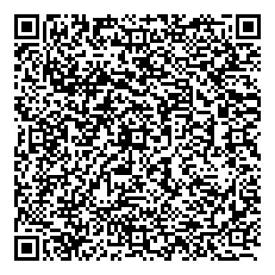
Survey QR Code:

