Slide 1
Recognition and Diagnosis of Childhood Behavioral Disorders
Alex Moore dnp, PMHNP-BC

Slide 2
About me
Psychiatric Mental Health Nurse Practitioner
Clinical Background – Emergency and Acute Consultation
  Inpatient Psychiatry
PMHNP Concentration Coordinator
  MSN and DNP

Slide 3
Goals of this Presentation
Provide the clinical perspective
  The perspective of a clinician
  Insight into processes, systems, etc.
Non-clinical Background
Diagnostic process / Diagnostic Thinking
Increase Recognition
Introduce Disorder -> Summarize DSM Criteria -> Clinical “Pearls”

Slide 4
Diagnostic Process
Diagnostic and Statistical Manual of Mental Disorders
  American Psychiatric Association
Objective Criteria
Diagnosis largely through observations/reports of behavior
Observers include
  Parents, family, teachers, etc.
Observation can be biased/skewed
DSM – Not perfect…but it helps!
  Objective

Slide 5
Diagnostic Process
Why is accurate diagnosis important?
  Tailored treatment -> Better Outcomes
  Pharmacotherapy Accuracy
Primary Care
  “ADD” Default Diagnosis
  Psychiatric Specialist
Many times diagnosis is overt/obvious
  Many times is not…”gray area”
Multiple Diagnoses and diagnoses must be revisited
Diagnoses outside of these conditions

Slide 6
Pharmacotherapy
The preference is always no prescribing in children
  Developing
  Growth
Cultural Pill Society
  Often environmental, parenting, resources, etc.
Therapy must be involved
Rx only when absolutely necessary
  …and it can be!
  Default should be none
Increase Functioning in associated environment

Slide 7
Specific Disorders
4 Specific Disorders of Childhood/Adolescence with a behavioral component
Compare, contrast, demonstrate diagnostic thinking
Increasing acuity/degree of potential behavioral disturbance
Is there a reason?
“Primary Disorders”

Slide 8
Attention-Deficit/ Hyperactivity Disorder

Slide 9
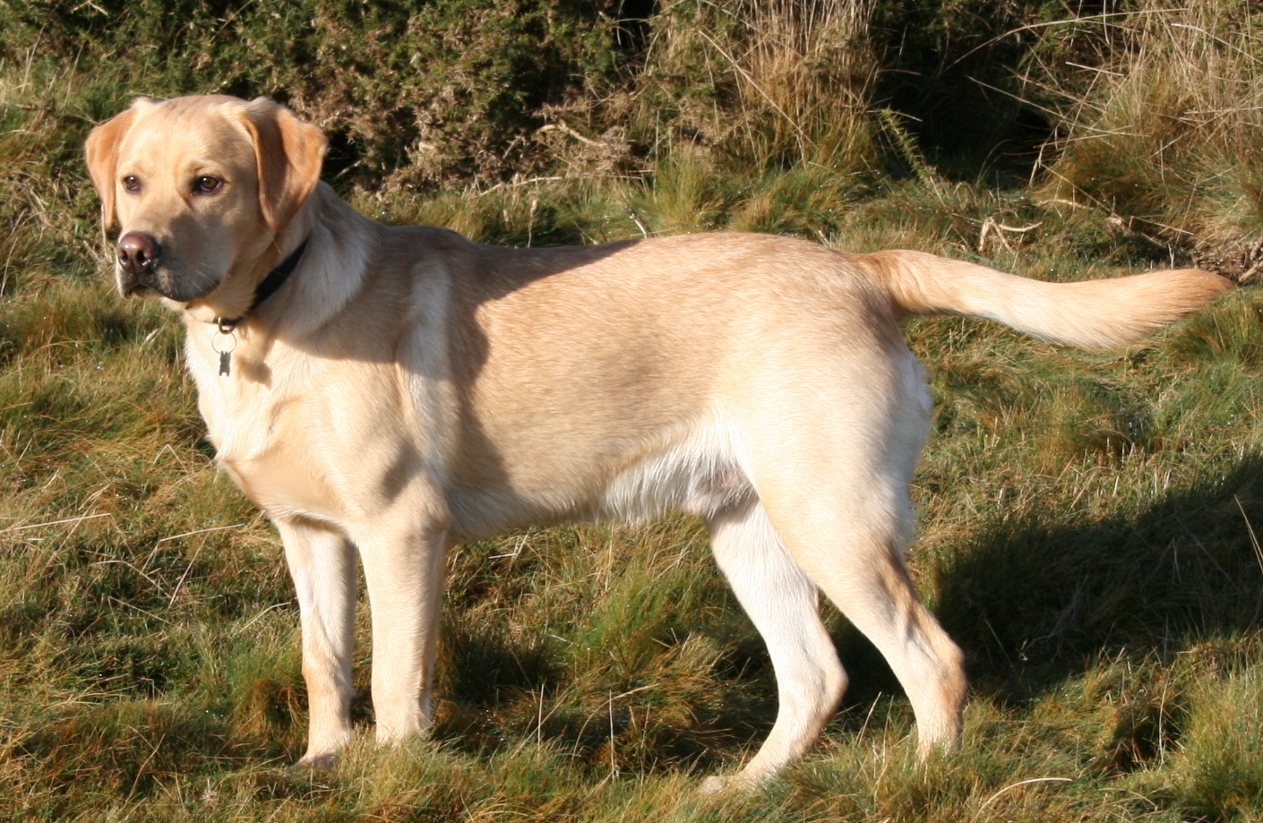

Slide 10


Slide 11
Attention-Deficit/ Hyperactivity Disorder
Neurodevelopmental Disorder
Neurochemical Origin -> Prefrontal Cortex
  Impulse Control
Statistically the most common
First consideration with behavioral issues

Slide 12
DSM Criteria - ADHD
A persistent pattern of inattention and/or hyperactivity-impulsivity that interferes with functioning or development as characterized by six or more of the following symptoms persisting for 6 months
Inattention
  Fails to give attention to details/careless mistakes
  Difficulty sustaining attention in tasks or play
  Does not seem to listen when spoken to directly
  Does not follow through with instructions (schoolwork)
  Difficulty organizing tasks
  Reluctant to participate in certain tasks
  Loses things necessary for tasks

Slide 13
DSM Criteria - ADHD
Hyperactivity and impulsivity
  Fidgets or taps hands/feet or squirms
  Often leaves seat in situations where they shouldn’t
  Runs or climbs where inappropriate
  Often unable to play quietly
  “on the go” “driven by a motor” (cannot be still)
  Talks excessively
  Blurts out answers before question is complete
  Difficulty waiting their turn
  Interrupts and intrudes on others

Slide 14
DSM Criteria - ADHD
Several Symptoms present prior to age 12
Two or more settings
Impair Functioning and not better explained by another disorder

Slide 15
Clinical Pearls- ADHD
Think of the good times!
Behavioral Problems
  Not overly “mean” or defiant
  Usually very loving
Want to focus and follow rules
  Biochemically cannot filter and control responses
Medication can be effective
Good times
  Play, creative exercises, unrestricted time, etc.
Bad times
  Focus, wait, sit still…

Slide 16
Clinical Pearls- ADHD
No good times….?
Start to think other disorders

Slide 17
Disruptive Mood Dysregulation Disorder

Slide 18
Disruptive Mood Dysregulation Disorder
Depressive Disorder
  Mood
Severe, persistent, irritable, angry, etc.
“Not Pleasant”
Temper tantrums
  Outbursts, verbal, behavioral, slamming, breaking, screaming, etc.
Outbursts disproportionate to age and degree of stimulus/situation
Onset 6-10 years old and would not be diagnosed after 18

Slide 19
DSM Criteria - DMDD
Severe recurrent temper outbursts, verbal and/or behavioral
  Out of proportion to provocation/situation
Outbursts out of proportion to developmental stage (age)
Occur on average 3 or more times per week
Two to three settings
12 months total duration without 3 or more months symptom free
Chronic severe, persistent, irritability
With these defined tantrums/outbursts

Slide 20

Clinical Pearls- DMDD
“Tantrums” Change in Adolescence
  Volatility in relationships
  Friends, Family, etc.
  “Everybody is a jerk!”
Late adolescence
  Move towards more depressive and anxiety symptoms related to relationships

Slide 21
Clinical Pearls- DMDD
Are there good times?
  No good times!
Persistent irritability/mood
Medication therapy is indicated
Must have therapy!
Can coexist with ADHD
  Mood Symptoms and Impulsive/Attention Symptoms

Slide 22
Oppositional Defiant Disorder

Slide 23
Oppositional Defiant Disorder
Disruptive, Impulse-control, and Conduct Disorders
Defiance
Arguing
Younger (Pre-school/Early School Age)
  3-8
Clear Environmental Risk Factors
  Persistent controlling by parents
Parental overreaction to any display of autonomy
  Age 3-8
  Crucial Developmental stage for automomy

Slide 24
DSM Criteria - ODD
A pattern of angry/irritable mood, argumentative/defiant behavior, or vindictiveness lasting at least 6 months as evidenced by at least 4 of the following
Angry/Irritable Mood
  Often loses temper
  Often touchy/easily annoyed
  Often Angry or resentful

Slide 25
DSM Criteria - ODD
Argumentative/Defiant Behavior
  Often argues with authority figures or with adults
  Often actively defies or refuses to comply with requests or rules
  Often deliberately annoys others
  Often blames others for mistakes or misbehavior
Vindictiveness
  Has been spiteful or vindictive at least twice in the past 6 months

Slide 26

Clinical Pearls- ODD
Compare to ADHD
  No “Good times”
  Purposefully refusing rules
Compare to DMDD
  Younger age
  Not really outbursts or tantrums
More of an “attitude”
“EVERYTHING IS AN ARGUMENT WITH THEM!”
  Every little ask
Like to annoy others
  Easily annoyed

Slide 27
Clinical Pearls- ODD
Not dangerous or physically destructive
Good prognosis
  Therapy is more effective than medications
  Medications are less effective
Family therapy
  Parents adjust
Attitude more than behavior

Slide 28
Intermittent Explosive Disorder

Slide 29
Intermittent Explosive Disorder
Disruptive, Impulse-control, and Conduct Disorders
Tantrums/outbursts without the baseline irritability/mood
Children and young adults
Angry response to disproportionate stimulus
“Out of control”
Failure to control aggressive impulses
Two classifications –
  High frequency / low intensity
  Low frequency / high intensity

Slide 30
DSM Criteria - IED
Recurrent behavioral outbursts representing a failure to control aggressive impulses as manifested by either –
Verbal Aggression
  Tantrums, tirades, verbal arguments/fights
Physical Aggression
  Towards property, animals, or others
Twice weekly on average for 3 months
OR
  Three outbursts involving damage or destruction of property or physical assault involving physical injury against animals/people in a 12 month period

Slide 31
DSM Criteria - IED
Not premeditated
Grossly out of proportion to situation
At least 6 years old

Slide 32

Clinical Pearls - IED
Compared to DMDD
  No baseline irritability/mood
“We don’t know where this comes from!”
High Frequency / Low Intensity
  Not as profound more verbal
  No physical harm or destruction
  2x weekly for 3 months
Low Frequency / High Intensity
  Physical injury to people/animals and/or destruction
  3 in 12 months

Slide 33
Conduct Disorder

Slide 34
Conduct Disorder – Risk Factors
Parent(s) with antisocial personality disorder
Chaotic Parenting
Lack of social involvement or social support
Chronic exposure to violence
Poorly developed sense of empathy
Could be environmental or genetic

Slide 35
Conduct Disorder – Characteristics
Absence of empathy
Lack of respect for the basic rights of others
Breaking age appropriate norms
Major/Serious rule violations
  Disregard for laws
Deceitfulness and Theft
Aggressive towards people/animals
Running away
Destruction of property

Slide 36
Summary
ADHD
  Not intentionally defiant, no baseline irritability
  Good times!
DMDD
  Persistent baseline mood/irritability
  Disproportionate temper tantrums/outbursts
ODD
  Strict Parental Environment
  “Everything is a fight”
  Attitude, Arguing
IED
  More extreme tantrums/outbursts but without the baseline irritability of DMDD
Conduct Disorder
  Absence of empathy and total disregard for rights and laws
  Destroying, hurting, stealing, etc.

