Slide 1
Rethinking Challenging Behavior: An Interdisciplinary Approach
Randall Gilmore
Direct Instruction

Slide 2
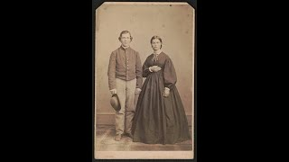
Top Ten in Ten!
https://youtu.be/z1vhCBhGhHA

Slide 3
01
Hook

Slide 4
02
Stories

Slide 5
03
Personal Connections

Slide 6
04
Questions

Slide 7
05
Feedback

Slide 8
06
Activities

Slide 9
07
Reflection

Slide 10
08
Humor

Slide 11
09
Affection

Slide 12
10
Withitness

Slide 13
https://youtu.be/CBqlDWHkdHk

Slide 14
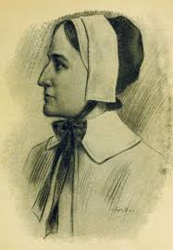
“Her Story” - Not Just History!
Influential Women in American History by the Century
17th …… Anne Hutchinson

Slide 15
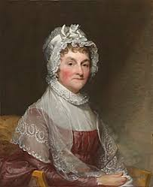
“Her Story” - Not Just History!
Influential Women in American History by the Century
18th …… Abigail Adams

Slide 16
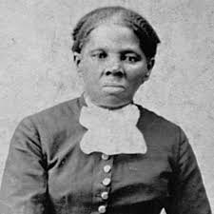
“Her Story” - Not Just History!
Influential Women in American History by the Century
19th …… Harriet Tubman

Slide 17
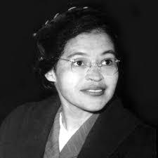
“Her Story” - Not Just History!
Influential Women in American History by the Century
20th …… Rosa Parks

Slide 18
NOW YOUR TURN
Name a woman in American History who inspires you…
21st ……

Slide 19
Discussion
Discuss an unheralded woman who inspired(s) you. How is she inspiring?

Slide 20
Reflection
Direct instruction is more than a lecture! When done well, Direct Instruction promotes engagement, enhances classroom management by helping to counter challenging behavior, and facilitates relationship-building.
How can you ensure that Direct Instruction in your classroom is effective?

Slide 21
Rethinking Challenging Behavior: An Interdisciplinary Approach
Randall Gilmore
Thank you
Direct Instruction

