Slide 1
Criminal Justice Issues in Schools:
Restorative Justice
Jennifer Mongold
Gracie Good

Slide 2
OBJECTIVES
Relationship between education and the justice system
What is restorative justice?
How is restorative justice applied?
Why restorative justice in schools is important
Practical ways that restorative justice principles are used at Sulphur Springs Elementary School

Slide 3
SCHOOL TO PRISON PIPELINE

Slide 4
Education and Crime Statistics
41% of U.S. inmates do not have a high school degree (Bureau of Justice Statistics)
In Texas between 1999 and 2007, 10 percent of disciplined students eventually dropped out compared to 2 percent of other students (2011).
One in every 10 young male high school dropouts is in jail or juvenile detention, compared with one in 35 young male high school graduates (2009).

Slide 5
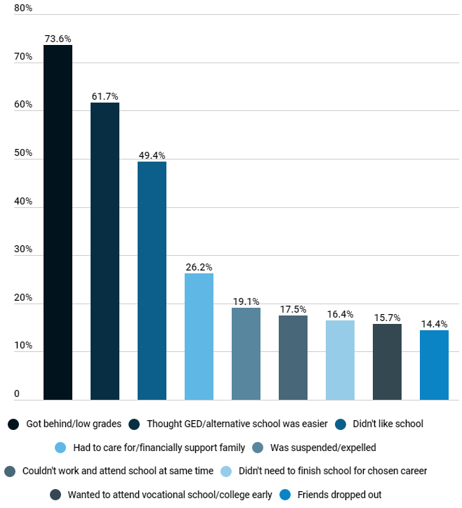

Slide 6
Exclusionary Punishment Issues
Youth that drop out of school seek out gang membership (Barnert et al., 2015; Gass & Laughter, 2015)
Expulsion and suspension disengage the student from academic achievement (Skiba et al., 2014).
Youth that drop out of school are eight times more likely to be incarcerated (Skiba et al., 2014).
Excluding children limits their chances of learning at the same pace as their peers (Justin, 2021).
Suspensions and Expulsions can ultimately cause students to drop out of school (Pigott et al., 2018).
Notes:
Point 1: to find a sense of belonging within a group, to find acceptance from peers, and to combat low self-esteem and negative social interactions because they lack an adult role model

Slide 7
Racial Disparities
African American girls over five times more likely than white girls to be suspended or expelled (Skiba et al., 2014)
Black students are two to three times more likely to experience exclusionary discipline event than White students for disruption and defiance (Yang et al., 2018).

Slide 8
What is Restorative Justice?
RJ is a theory of justice that:
emphasizes repairing the harm caused or revealed by bad behavior
is best accomplished through cooperative processes
includes all stakeholders

Slide 9
Types of Restorative Justice
Mediation after conflict (i.e., fight, bullying, insubordination)
Circles
Restorative Discussions

Slide 10
What does Restorative Justice Offer?
An alternative to exclusionary punishments
Teaching children and teens how to handle conflict
Relationship building
Notes:
Large group question

Slide 11
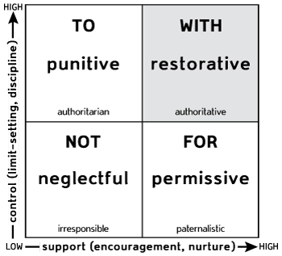
How does Restorative Justice Work?: Social Discipline Window
My Way
Our Way
No Way
Your Way

Slide 12
Retributive V. Restorative Punishments
Restorative
Accountability
Fix the imbalance
Vindication
Retributive (Traditional)
Pain to fix the imbalance
Vindication

Slide 14
Restorative Practices at Sulphur Springs
Washington County Programs
Olweus and Boys Town Press
Developing relational and personal skills
Resilient Schools Project
Trauma-Informed Trainings
Strong Brain Institute - ETSU
School-Wide Discipline
School Culture
Students feel safe at school
Notes:
Overview of Olweus and Boys Town Press - positive behavior programs that impact student relationship and relate to restorative circles

Slide 15
School Wide Approaches
Restorative Circles
Students foster a supportive, respectful, and inclusive school environment that prioritizes the well-being and development of all students.
Modeling appropriate behavior
Conflict Resolution
Communication Skills
Sense of Safety

Slide 16
School Wide Approaches

Slide 17
Change in Discipline
Essential Focus - repairing harm, building and cultivating relationships, and promoting conflict management ( Lodi, E., et al. 2022)
Change in matrix - alignment with restorative practices
Zero tolerance policy impacts students who need community connections and learning environments the most.
Students understand the consequence
Accountability
Clear expectations
Less office referrals

Slide 18
Discipline Matrix Example
Classroom Behaviors | 1st Offense | 2nd Offense | 3rd Offense | 4th Offense
Talking Out | VW, Model behavior | C, PC, RGC | 3 Points, LP, RSW | D, RFH
Out of Seat | VW, Model behavior | C, PC, Practice during recess, RGC | 3 Points, LP, RSW | D, RFH
Off Task | VW, Model behavior | C, PC, RGC | 3 Points, LP, RSW | D, RFH
Disruptive Behavior | VW, Model behavior | C, PC, Get a Peer Helper, RGC | 3 Points, PC in person, LP, RSW | D, RFH
Cheating | Redo, C, PC, RGC | 3 Points, PC, RSW | 6 Points, D, RFH | ISS, Support Plan
Homework & Assignments | C, Complete during recess | Complete in office, LP, PC, RGC | PC, D, RSW | D, ISS, RFH
Toys & Distractions | VW, Put away | C, 3 Points, RGC | 6 Points, PC, RSW | PC, D, RFH
Not Following Directions | VW, Model behavior | C, PC, LP, RGC | D, RSW | ISS, RFH
Not Using Time Properly | VW, Model behavior | C, PC, LP, RGC | 3 Points, PC, RSW | D, RFH

Slide 19
Stories of Success
Classroom Level
Conflict Resolution
Behavior
Counseling Sessions and Restorative Conversations
Repairing Friendships
Office Referrals
Administration guiding the conversations
Bullying
Student disrespect towards teacher
Family connections
Student Voice

Slide 20
Making the Shift

Slide 21
Resources
International Institute for Restorative Practices:
https://www.iirp.edu/professional-development/restorative-practices-for-educators
Strong BRAIN Institute at ETSU:
https://www.etsu.edu/institute/strong-brain/
Gracie Good: goodg@wcde.org
Jennifer Mongold: jlmongold@king.edu

Slide 22
References
Barnert, E. S., Perry, R., Azzi, V. F., Shetgiri, R., Ryan, G., Dudovitz, R., Zima, B., & Chung, P. J. (2015). Incarcerated youths' perspectives on protective factors and risk factors for juvenile offending: A qualitative analysis. American Journal of Public Health, 105(7), 1365–1371. https://doi.org/10.2105/AJPH.2014.302228
Gass, K. M., & Laughter, J. C. (2015). “Can I make any difference?” Gang affiliation, the school-to-prison pipeline, and implications for teachers. Journal of Negro Education, 84(3), 333–347. https://doi.org/10.7709/jnegroeducation.84.3.0333
Justin, E. (2021). Stopping the Flow: Eliminating the school-to-prison Pipeline in Washington State. Seattle Journal for Social Justice, 19(2), Article 17. https://digitalcommons.law.seattleu.edu/sjsj/vol19/iss2/17
Lodi, E., Perrella, L., Lepri, G. L., Scarpa, M. L., & Patrizi, P. (2021). Use of Restorative Justice and Restorative Practices at School: A Systematic Literature Review. International journal of environmental research and public health, 19(1), 96. https://doi.org/10.3390/ijerph19010096

Slide 23
Pigott, C., Stearns, A. E., & Khey, D. N. (2018). School resource officers and the school-to-prison pipeline: Discovering trends of expulsions in public schools. American Journal of Criminal Justice, 43(1), 120–138. https://doi.org/10.1007/s12103-017-9412-8
Skiba, R. J., Arredondo, M. I., & Williams, N. T. (2014). More than a metaphor: The contribution of exclusionary discipline to a school-to-prison pipeline. Equity & Excellence in Education, 47(4), 546–564. https://doi.org/10.1080/10665684.2014.958965
Yang, J. L., Anyon, Y., Pauline, M., Wiley, K. E., Cash, D., Downing, B. J., Greer, E., Kelty, E., Morgan, T. L., & Pisciotta, L. (2018).“We have to educate every single student, not just the ones that look like us”: Support service providers' beliefs about the root causes of the school-to-prison pipeline for youth of color. Equity & Excellence in Education, 51(3–4), 316–331. https://doi.org/10.1080/10665684.2018.1539358

Slide 24
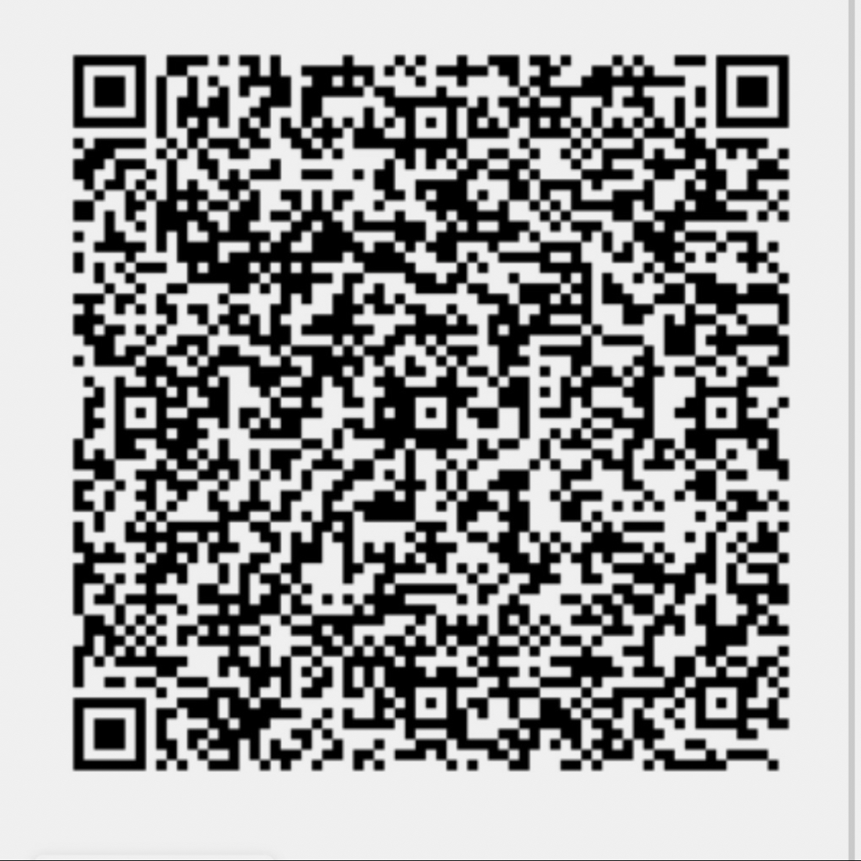
Thank you!

